Slide 1


Black in Robotics Intro to Artificial Intelligence using Python
Aaron Shepard
Software Systems Engineer
NASA Goddard Space Flight Center

Slide 2

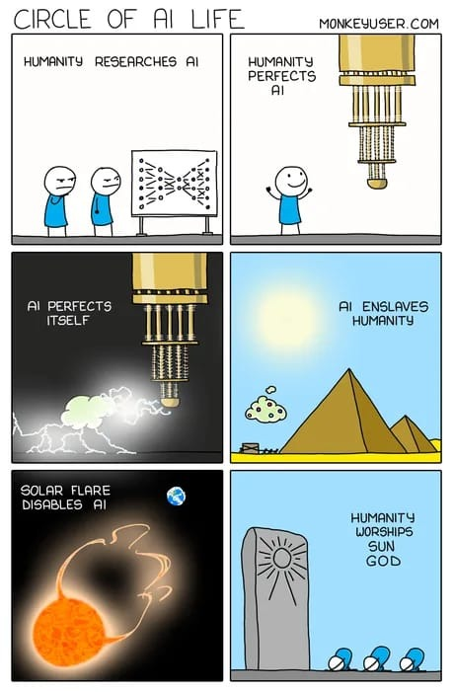

Slide 3
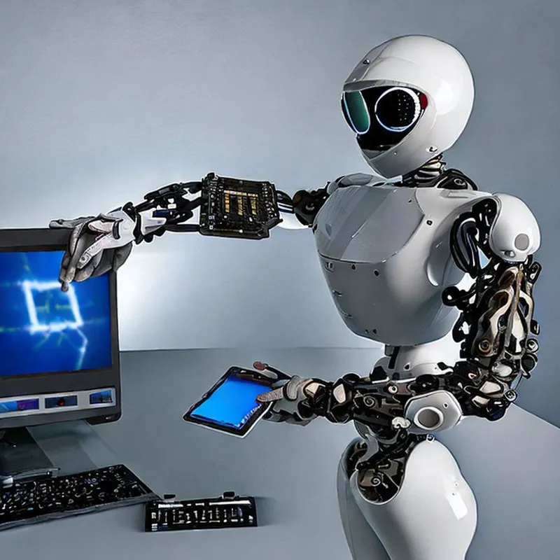
Learning Objectives
What is AI ?
Components of an AI Robotics System
Image Processing
Path Planning
Control Policy Development

Slide 4


Software Needed
Python IDE: Anaconda, Spyder, Pycharm, etc..
GitHub Repo: https://github.com/SpaceCadetShep0727/BiR-intro-to-AI
Optional: https://vr.vex.com/

Slide 5
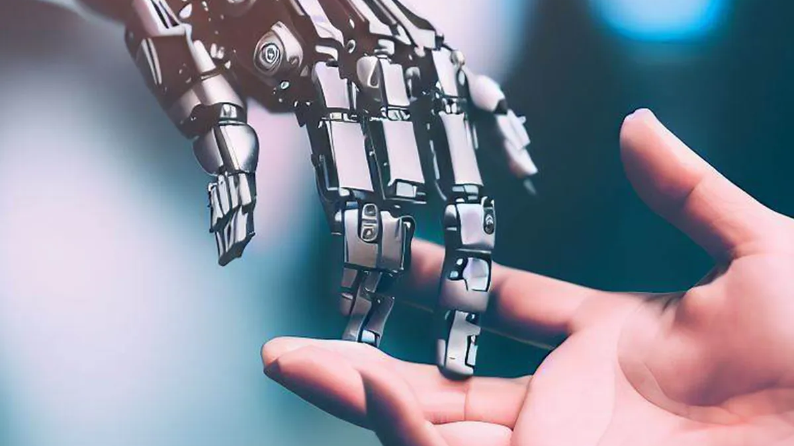
AI and Autonomous Systems

Slide 6
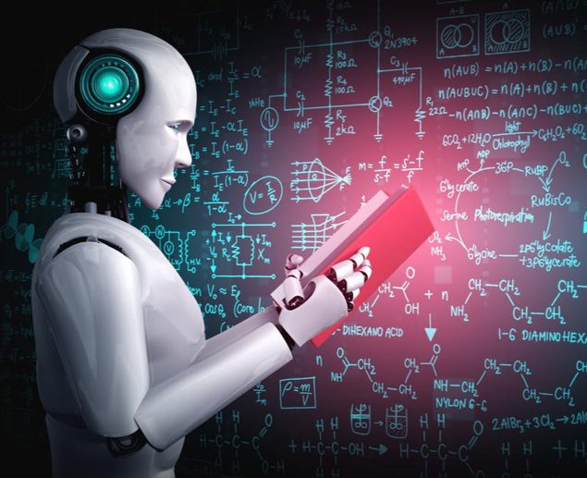
What is Artificial Intelligence
The demonstration of intelligence by machines instead of humans/ other animals
Multiple subfields of AI research including: reasoning, knowledge representation, planning, learning, natural language processing, perception, and object manipulation
Mostly implemented today using highly mathematical/statistical machine learning algorithms
Notes:
Parallel is faster, but the trade off is that it requires more hardware pins

Slide 7
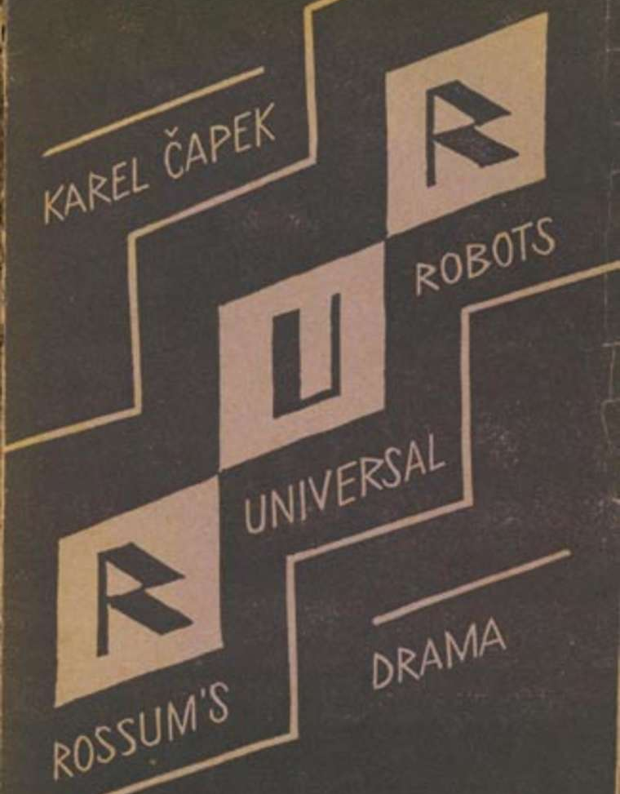
Origins of AI
First appeared in science fiction novels such as RUR (1920s). Concepts from these stories are still discussed in modern AI ethics
By the 1950s there were visions on how to achieve AI
Symbolic AI and Connectionist approach

Slide 8

Symbolic AI
Used computers to create symbolic representations of the world and systems that could reason about the world
Think “heuristic searches” where intelligence is exploring the space of possibilities for an answer
This was the dominant paradigm of AI research from the 1950s – 1990s
Eventually researchers began doubting the that symbolic approaches could imitate all processes of human cognition , so they developed sub-symbolic approaches such as artificial neural networks

Slide 9

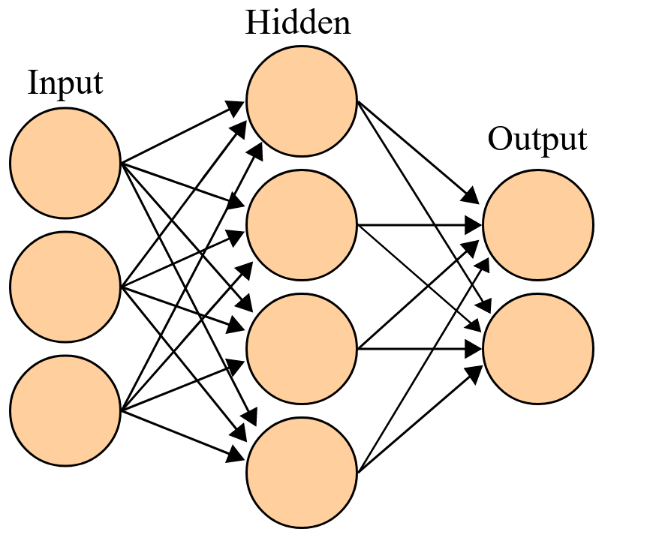
Connectionism
Principle that mental phenomena can be described by interconnecting networks of simple/ uniform units (i.e. neurons and synapses)
Distributed signals activity via connections can be represented numerically and learning is modifying the strength of the connections based on experiences
Heavily based in statistics and mathematical optimization
Success of deep learning networks in the past decade have increased the popularity of this approach

Slide 10



3 Components of An Autonomous Robotics System
Sense – Perceive the environment using external sensors/ devices
Cameras, lidar, ultrasonic, IR
Think- Make decisions based on perceived environment from sensor data
Path planning algorithms (RRT, A*, D*, etc.)
Act- Carry out those decisions

Slide 11
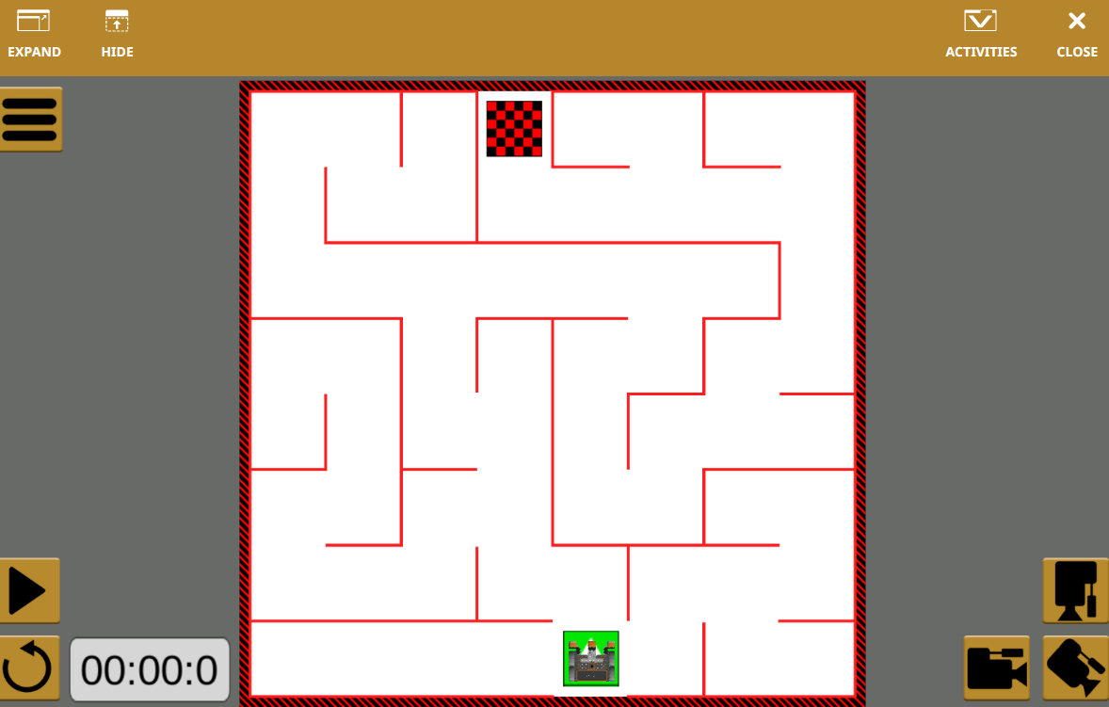
Our Robotic System
Our robot is stuck in a maze and we need to teach it how to get itself out
Sense- Image processing
Think- Path planning
Act- Control policy ***

Slide 12

Intro to Image Processing

Slide 13

What is Computer Vision
Acquiring, processing, analyzing, and understanding digital images
Subdomains- scene reconstruction, object detection, tracking, object recognition

Slide 14
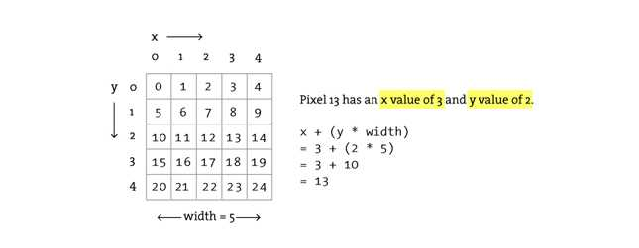
What Are Pictures Made of
Digital images are made of pixels which are the smallest addressable element in display device
Typically the first pixel in an image is located on the top left corner of the image with the width (x) extending to the right and the height extending downwards

Slide 15
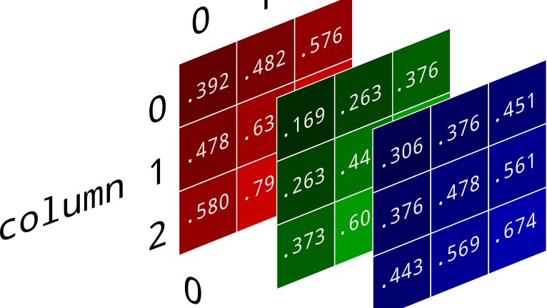
Pixel Manipulation
In RGB color images each pixel will have 3 addressable channels (Red, Green, Blue)
Each channel is represented by a byte (0-255)
Why RGB?
What this means is that colored pixel data is 3 dimensional
Images can be processed by reading and changing the pixel data

Slide 16
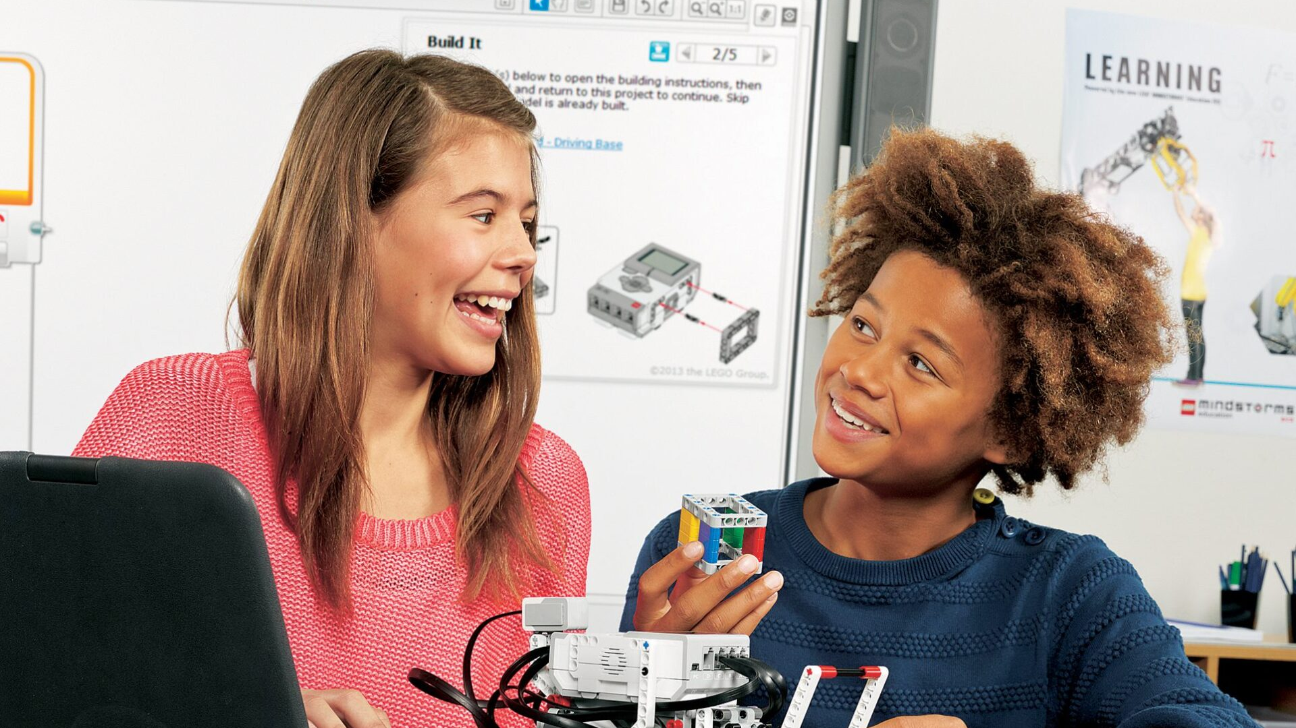
Breakout Session

Slide 17
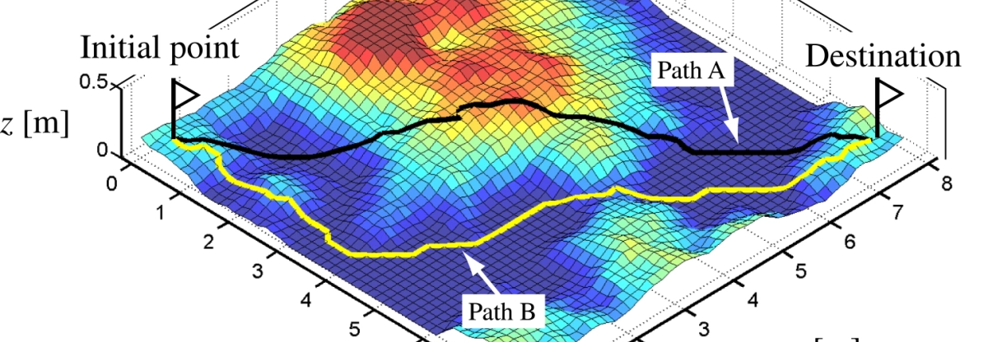

Path Planning

Slide 18
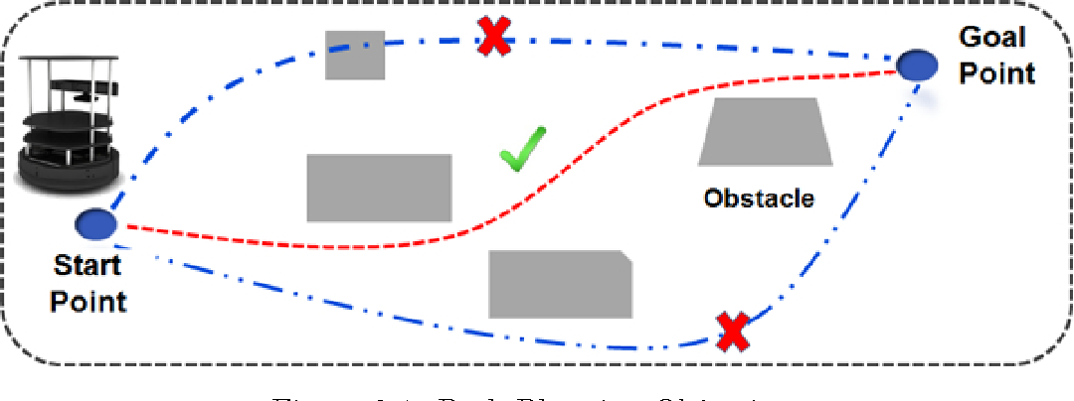
Motion/ Path Planning
A computational problem to find a sequence of valid configurations that moves an object from a start point to a destination
This allows autonomous vehicles/ robots to find the shortest and/or the most obstacle free path from a start state to a goal state
Requires a map of the environment, along with a start and goal state
Different Algorithms A* ,D* , RRT

Slide 19

Rapidly Exploring Random Tree (RRT)
Designed to efficiently search nonconvex high dimensional spaces
Randomly builds a space filling tree
Used to generate open loop trajectories for non-linear systems with state constraints
Good , but not the best option for this problem

Slide 20
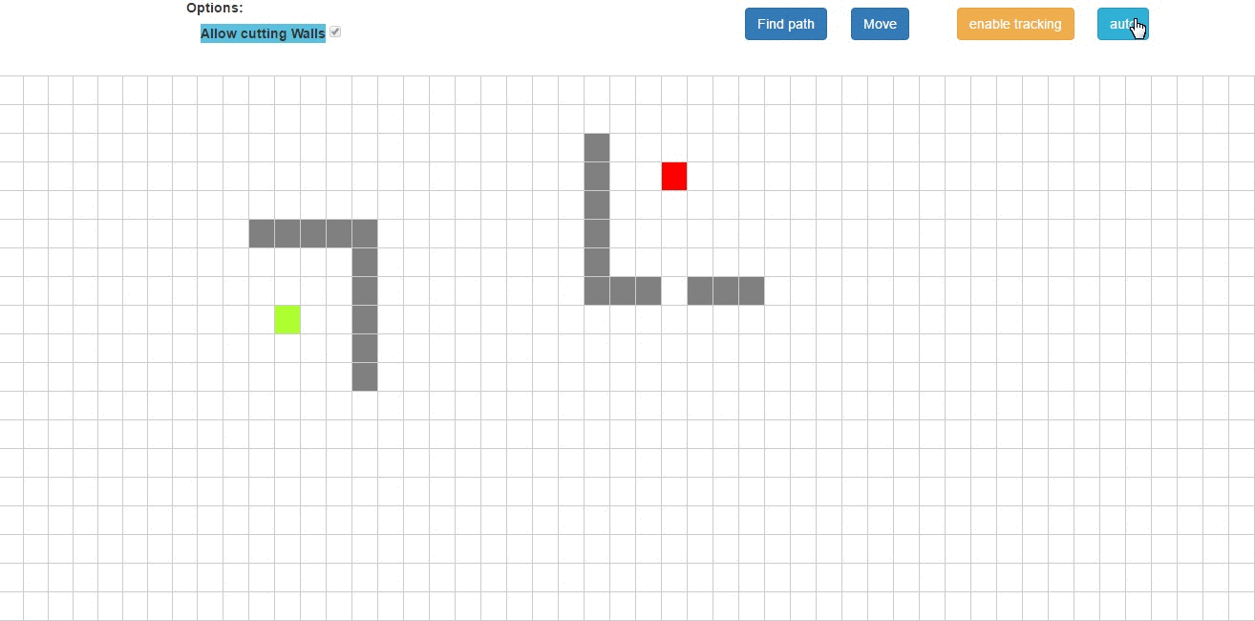
A* Algorithm
Graph traversal and path search algorithm
Informed search
Formulated in the terms of weighted graph
Looks for the path to goal node with least cost (shortest distance)
Maintains a tree of paths originating at the start node and extends path
edge at a time until goal node is reached
Great for solving mazes
Cons:
Space complexity( stores all generated nodes in memory)
Outperformed by algorithms that can preprocess the graph

Slide 21
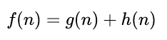
A* Algorithm
At each iteration A* determines which path to extend based on the cost of the path (distance from start node) and the estimated cost to extend the path all the way to the goal
n= next node on the path g(n) – cost from start, h(n) heuristic cost to goal
Typical implementations use a priority queue to perform the repeated section of minimum cost nodes to expand. At each step the node with the lowest f(n) is removed with the f and g values updated. This continues until the removed node is the goal node

Slide 22
Breakout Session

Slide 23
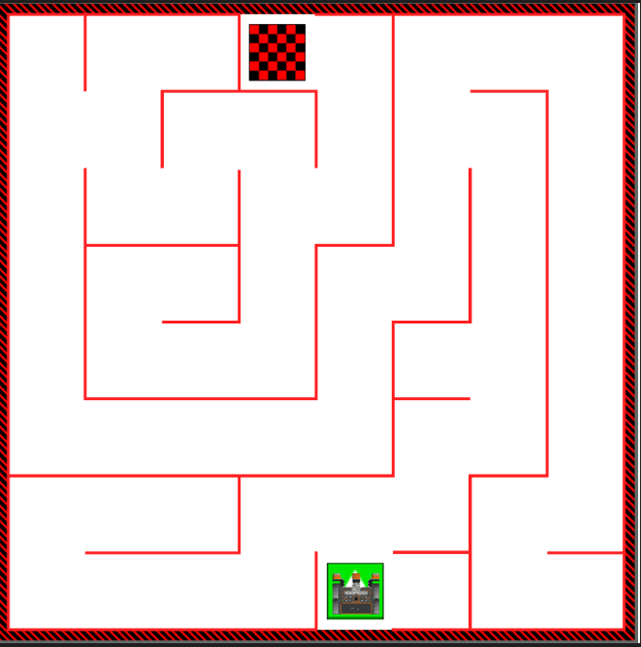

Combining A* and Image Processing
How can we get this maze onto this algorithm grid?

Slide 24
Breakout Session

Slide 25
What We Will Cover Next Time
Motion policy development
Data transfer
Sensor fusion

Slide 26


